Slide 1

  Funding models for Disaster Risk Reduction (DRR) and disasters management
  National Disaster Management Strategic Indaba
PRESENTED BY:
Dr. Letsepa Pakkies
UNIT: INTERGOVERNMENTAL RELATIONS
DATE: 14 April 2026

Slide 2
Overview of the presentation
Funding models for Disaster Risk Management activities in South Africa
Conditional Grant Reforms: implication for the disaster grants
Strengthening accountability and compliance
Emergency Procurement

Slide 3
  Funding models for disaster risk management activities in the county

Slide 4
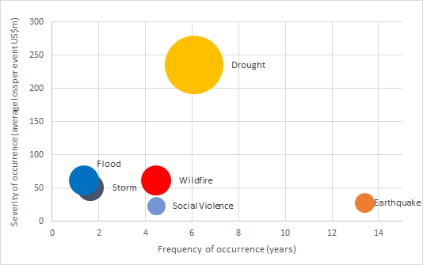
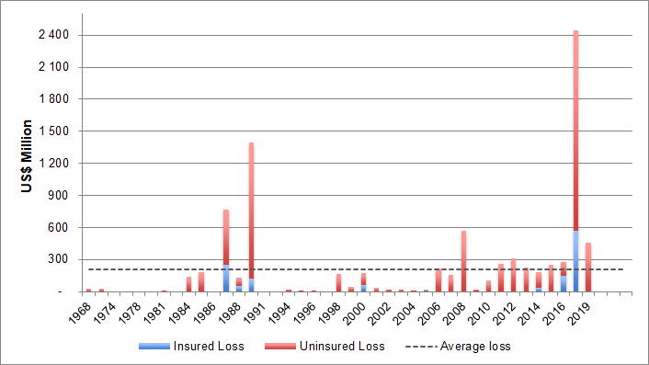
Drought is the most severe peril while flood and storm are the most frequent
Disaster risk profile and impact of past disasters
Drought is a high severity medium frequency risk
  Extensive financial impact mainly due to loss of productivity and livelihoods
Flood and storm are low severity high frequency risks
  Localized impact mainly through property damage
Wildfire is a medium severity medium frequency risk
  disproportionate impact on the rural and poor population.
On average, up to 86% of losses are uninsured, creating a large protection gap into which the Government often provides financial support

Slide 5
The three-sphere structure of the government creates both opportunities and challenges to the efficiency of disaster risk financing
Institutional set-up and instruments
STRENGTHS
OF THE MULTI-SPHERE SYSTEMS IN DRF
CHALLENGES
OF THE MULTI-SPHERE SYSTEMS IN DRF
Understanding of local-level risk exposures
Ability to develop tailored DRF instruments
Knowledge of local distribution channels, speeding up the procurement process
Base for a robust risk-layering strategy with higher tiers involved only during costlier events
DRF Principles
Simple procedures
Reporting and auditing adequate to disbursement size
Prioritization and rewarding of appropriate instruments
Complexity of the decision and audit process
Lack of ownership
Delays in disbursements
Lower transparency requiring more stringent procedures
Challenging balance between equity and efficiency when addressing local disaster risk exposure

Slide 6
South African government’s financing strategy
The government has a comprehensive risk layered strategy to finance disaster response
SEVERITY
International
IFI Emergency Loans (IMF, AfDB, WB)
SEVERITY
SEVERITY
OTHER
Heavy reliance on ex post funding (reprioritisation)
Funding gap between available resources and disaster costs (significant for larger events)
Limited pre-arranged financing and incentives for preparedness
Preparedness at subnational level is largely funded through equitable share and own revenue (disaster grants restricted to post-disaster response and recovery)
Household Insurance
Property, agriculture, health, fire
Public Assets Insurance
Municipal pools
RISK TRANSFER
Solidarity Funds
Mix of retention (public funds) and transfer (private funds) established for COVID-19 response)
Treasury: R100m
TOTAL: R3-4bn
Contingency Reserve
Managed by the National Treasury
R 0-10bn
Disaster Risk Management Grants and Funds
Managed by the National Disaster Management Centre DCoG
RISK
RETENTION
Monetary Policy Rate
Cost of government borrowing
FREQUENCY
Budget Mechanisms
Virements / Reprioritization
Up to 8% of line item
Adjustment budget(s)
Additional funds through shifts in funding (beyond 8% limits)
Amend agency cash flows
Department budgets spent in 8 (not 12) months; requires future allocations in adjustment budgets
Amend grant frameworks
Approve municipal use of funds in existing grant frameworks for shock response (Covid-19)
FREQUENCY
COVID:
-300bps
Thus, important to focus on: (i) improving efficiency of existing instruments; and (ii) adding low cost / efficient instruments (e.g. risk transfer, contingent credit)

Slide 7
Disaster Risk Financing Strategy
The National Strategy focuses on:
A key pillar of the national strategy is the requirement for provinces and municipalities to develop sub-national DRF strategies aligned to the national framework
  to strengthen disaster preparedness
  improve fiscal resilience
  enable faster and more effective disaster response and recovery at local level
The development of sub national strategies must align with existing national, provincial, and municipal disaster management frameworks, climate adaptation plans, and fiscal policies
Increasing the availability of funds
Improving distribution of funds
Enhancing disaster-related data collection

Slide 8
Increase the availability of funds to enhance fiscal and financial resilience to shocks
Involves a risk-layering strategy that diversifies the financial instruments used to manage and respond to disasters
Non-budgetary mechanisms
Sovereign parametric insurance
Indemnity insurance for public assets
Contingency funding beyond reserves
Mobilise private insurance uptake among households and businesses
Uses pre-determined indices to trigger payout, minimising lag in funding post-disaster
Coverage based on actual losses incurred, ensures infrastructure can be restored without depleting reserves
Augments the government's fiscal capacity to handle disasters by accessing additional funds from external sources when reserves are insufficient
Encourages the adoption of insurance at the individual and corporate levels, thereby reducing the fiscal burden on the state and promoting quicker recovery.

Slide 9
Improve the distribution of funds to address gaps in a response-efficiency-centred manner and timeliness
Improve grant mechanism
Inter-governmental coordination and capacity lacks, which leads to delays in fund allocation, especially to local government
Strengthen decentralised response
Decentralised response system to include NGOs and the private sector for rapid aid delivery to vulnerable communities
Business protection
Need to protect businesses and jobs, which is contingent on a robust private sector
Foster inter-institutional trust, task streamlining and revision of the incentive system that emphasises preparedness over reactive measures
Integrate agricultural businesses, a key economic sector, into disaster response systems for rapid stress identification and financial intervention
Does not mean that the state should assume the risk of businesses
Leverage private sector innovation
Incentivise private sector to innovate in financial resilience, which require collaboration for risk retention and response innovation
Use loan guarantee schemes to aid businesses during economic disruptions to ensure continued operation and employment
Focus on safeguarding business environment by being able to repair critical infrastructure
Consider objective triggers to be used for finance disbursement

Slide 10
Enhance data collection for better budgeting and efficient risk management
SA grapples with significant data gaps
International databases focus on large-scale events, overlooking smaller-scale disasters
On national level, SA lacks a centralised repository for information on disaster-induced losses, damages and expenditures
Data fragmentation
NDMC maintains GIS system for historically declared disasters
Interoperability barriers makes it difficult to combine different datasets
Strategies to improve data management
Programmers at SAEON has developed prototype of web-based national hazards events to address gaps
Collaboration with private insurance sector, which has valuable data on claims and payouts related to property and asset damages
Gaps between international databases on disaster occurrences
Challenges persist in linking data with disaster relief funding.
Collaboration crucial for developing innovative insurance instruments and accurate pricing
Improve assets registries
Align public asset registries with the requirements of insurers
Create incentives for municipalities to build, and maintain registries and to take out insurance for at least key assets
Support municipalities in negotiations with insurers
Create incentives for improving resilience of public assets and for implementing the “build-back-better” principle
Complicates forecasting and accurate budgeting for contingencies
Difficult to cost response
Essential for expanding coverage to householders affected by disasters.
Make insuring public assets impossible or very expensive

Slide 11
Conditional grant reforms: implication for the disaster grants

Slide 12
Conditional Grant Review – Reforms
Key systemic issues identified
  Proliferation and fragmentation of grants
  Weak alignment across sectors and spheres
  Over-reliance relative to the equitable shares
  Weak design and unclear rationale in some cases
Reform direction
  Reassert equitable share as primary funding instrument
  Use conditional grants as supplementary/last resort
  Consolidation and rationalisation of grants
  Strengthen “funds follow function” principle
  Improve integration into core planning and budgeting systems

Slide 13
Conditional Grant Review – Implications for disaster grants
Persistent weaknesses
  Reactive (post-disaster) rather than preventive
  Poorly integrated with broader resilience funding
  Slow expenditure and service delivery performance
  Proposed reforms
  Incentivize mitigation and preparedness
  Align disaster grants with climate adaptation and risk reduction
  Improve speed of allocation and disbursement

Slide 14
Emergency procurement

Slide 15
Legal basis for emergency procurement
Deviations provided for ito of PFMA/MFMA supply chain management frameworks and regulations
Specific National Treasury Instruction Notes (especially those issued during declared disasters, e.g. COVID-19 and flood responses)
Key principles across regulations and instruction notes
  Emergencies (as defined in SCM Instruction Note 3 of 2016/17), allow procedural flexibility, not regulatory bypass
  Accountability remains with the Accounting Officer
  Transparency (reporting and disclosure in financial statements) is mandatory
  Audit trail is non-negotiable
  Even without full competition, value for money must be demonstrated

Slide 16
Observed challenges
Capacity constraints, particularly at municipal level
Poor project preparation and planning
Fragmented funding and weak coordination
These challenges are systemic and cut across sectors

Slide 17
Critical processes required for compliance
Confirm and document the emergency (declaration and/or classification of a disaster)
Obtain Accounting Officer approval
Use the most competitive process possible under the circumstances
Select suppliers transparently (preferably existing/approved lists)
Ensure price reasonableness (where applicable, adhere to the relevant instruction notes)
Keep full documentation and audit trail
Report deviations to oversight structures
Disclose in financial statements
Monitor for fraud and conflicts of interest

Slide 18
THANK YOU!

